Slide 1


CAP404 INFORMATION SECURITY AND PRIVACY Lecture Zero
School of Computer Applications
Domain: AI & ML
Lovely Professional University

Slide 2
About the Course
This is an introductory course in cryptography and security risk management.
This course provides an introduction to information security and other fundamental concepts of risk management.
This course also discusses cryptocurrency, with a special focus on bitcoin and mining techniques.
Topics include layered computer security and privacy, cryptography fundamentals, cryptocurrency, risk identification, and assessment techniques.
At the end of the course there will be a discussion on various security and risk management techniques used in the computer system.

Slide 3
Text Book
CRYPTOGRAPHY AND NETWORK SECURITY BY ATUL KAHATE, M.G.Hills

Slide 4
Reference Books
R-1 INFORMATION SYSTEMS SECURITY - SECURITY MANAGEMENT, METRICS, FRAMEWORKS AND BEST PRACTICES SECOND EDITION BY NINA GODBOLE, BHUVAN UNHELKAR, WILEY

Slide 5
Course Organization
L T P of the course is 4 0 0, i.e, 4 hours of lecture per week for 14 weeks.
Evaulations:
3 Continuous Assessments will be held in the 5, 9th, and 12th weeks of the term. (A0203 (2 best out of 3))
Mid Term Exam will be held after week 7.
End Term Exam will be held after week 14.

Slide 6
Course Assessment Model
Assessment Criteria | Weightage
Attendance | 05%
Continuous Assessments | 25%
Mid Term Exam Theory | 20%
End Term Exam | 50%
Total | 100%

Slide 7
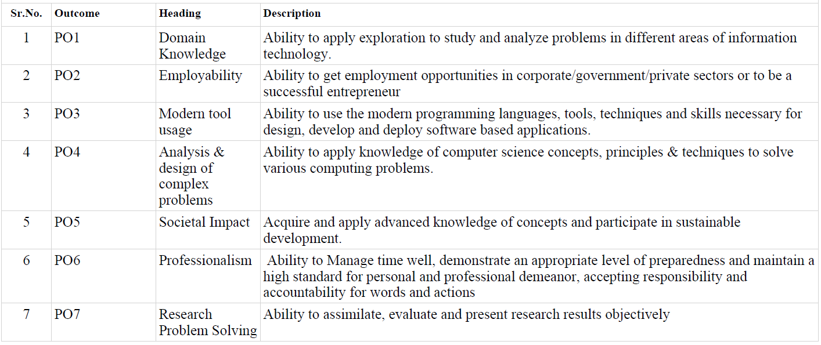
Program Outcomes

Slide 8
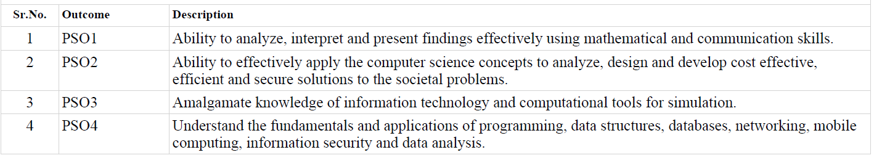
Program Specific Outcomes

Slide 9
Course Outcomes
CO1 :: define the fundamental security concepts and recognize importance of information security in the computer-driven world
CO2 :: explain the basics of cryptography and the working of cryptographic algorithms
CO3 :: demonstrate the underlying vulnerabilities of system and network Security
CO4 :: analyze the key privacy concepts in IT, principles, and requirements

Slide 10
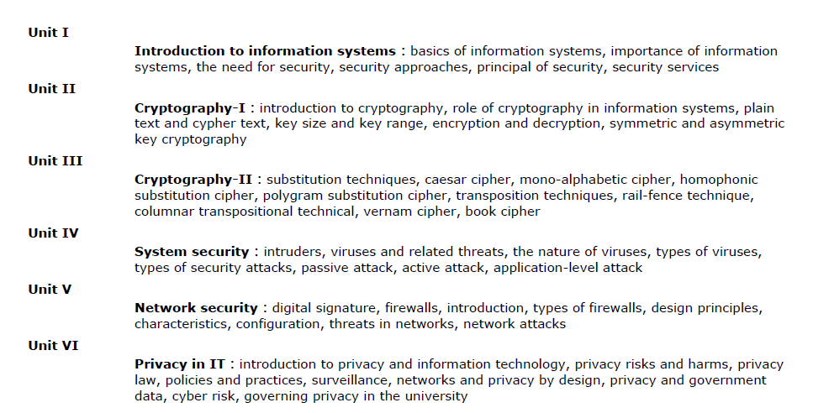
Syllabus

Slide 11

INTRODUCTION TO COURSE

Slide 12
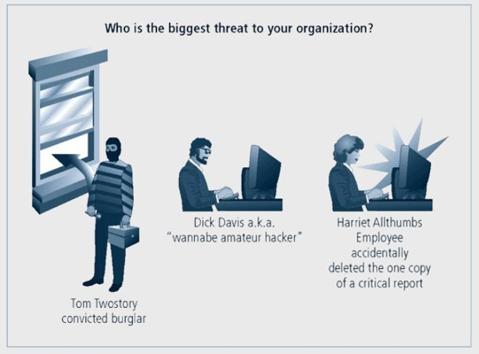
Acts of Human Error and Failure

Slide 13
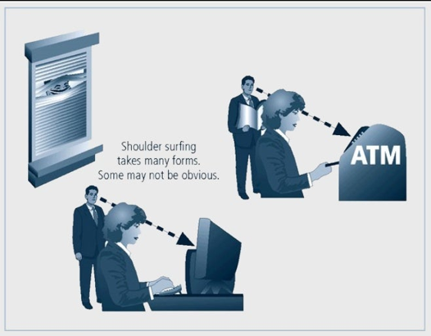
Continue..

Slide 14
What mistakes do people usually do?
Revealing classified information
Entry of erroneous data
Accidental deletion or modification of data
Storage of data in an unprotected area
Failure to protect information

Slide 15
What do you think about the cause?
Inexperience
Improper Training
Incorrect Assumptions
Hurry
Other Circumstances

Slide 16
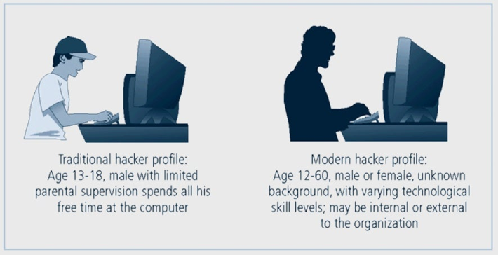
Hackers – Biggest Threat to Organization

Slide 17

5 Problems 1 Solutions

Slide 18
Other possible solutions
Organization must have a secure infrastructure
Additional security services may have been provided
More robust solutions may be needed
Must have information about the threats
Must identify the possible vulnerabilities

Slide 19
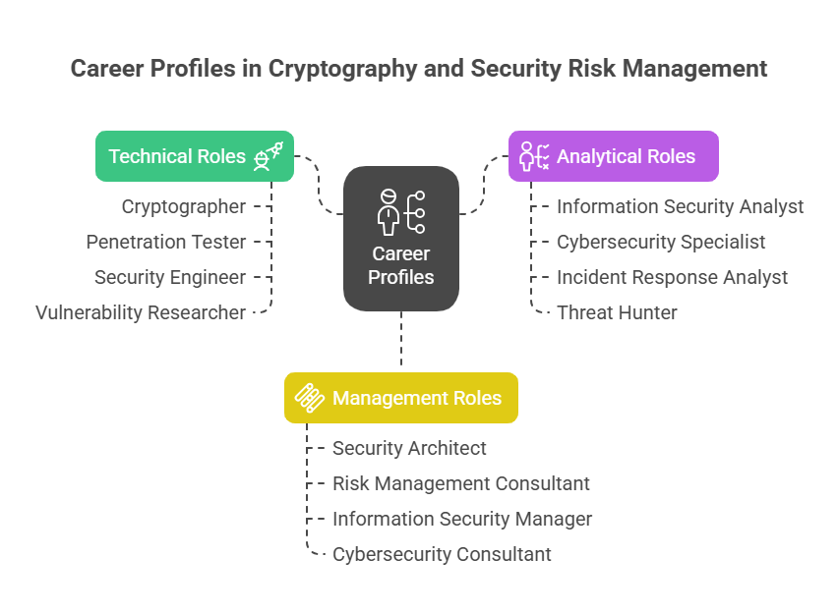

Slide 20

EDU Revolution
Learning Beyond the Classroom Division of Academic Affairs

Slide 21
Why EDU-Revolution!!!
Supports the 'Earn Your Fee' vision through Revenue Generation activities
Enhance Real World Skills ensuring Industry readiness
Promote Innovation and Creativity to handle real world challenges
Promote Lifelong Learning

Slide 22
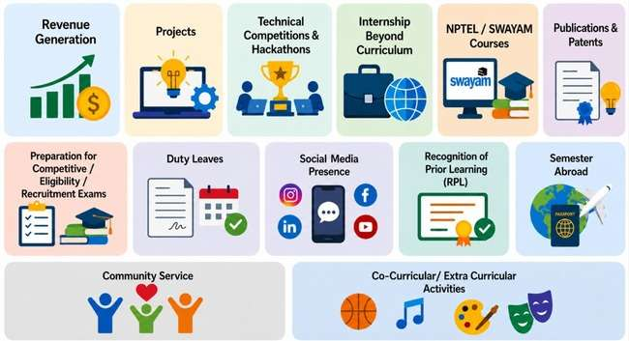
Initiatives under EDU Revolution

Slide 23
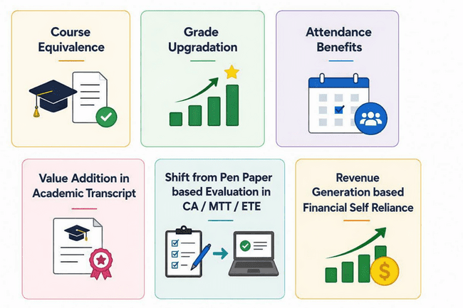
Academic and beyond Curriculum Benefits

Slide 24
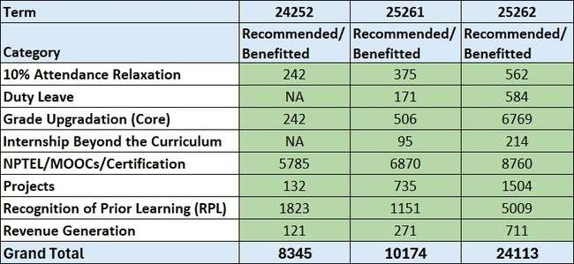
Edu Revolution continues to gain awareness and student participation

Slide 25
Why are Criteria Sheets Important?
It is a structured framework for evaluating EDU Revolution submissions to
Ensure Standardization
Enhance Transparency
Support Fair Assessment
Promote Accountability in assessment

Slide 26
Standing Committee
Standing Committee- it reviews EDU Revolution nominations and recommends eligible academic benefits.
Composition-
5–7 members constituted by the HoS
Additional members may be nominated by the HoS
All relevant committee coordinators are members ;

Slide 27





Processing of Student Nominations

Slide 28
Revenue Generation
Revenue Generation refers to income earned by students through entrepreneurial, professional, technical, creative, or service-based activities by applying their knowledge and skills.
Eligibility
💰Revenue must be generated through university-approved activities (family-owned businesses not considered)
💰No minimum CGPA requirement
💰Applicable only to courses in which the student has secured a passing grade (for grade upgradation)
💰A minimum of 60% attendance in current term.

Slide 29
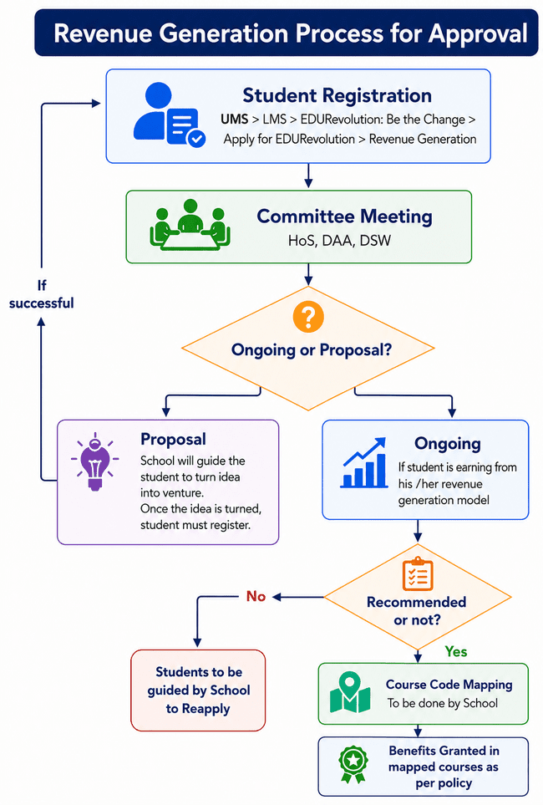

Slide 30
NPTEL/ Proctored MOOCs/Certifications
NPTEL, Proctored MOOCs, and Certifications refer to structured learning programs offered by recognized platforms and institutions that enable students to acquire additional knowledge, skills, and competencies beyond the regular curriculum.
Eligibility
🎓Course must be completed through a recognized platform approved by university
🎓Minimum CGPA of 7.0 for Students seeking Complete Course Equivalence
🎓No CGPA requirement for availing Partial Course Equivalence benefits
🎓Course content must be relevant to the mapped university course.

Slide 31
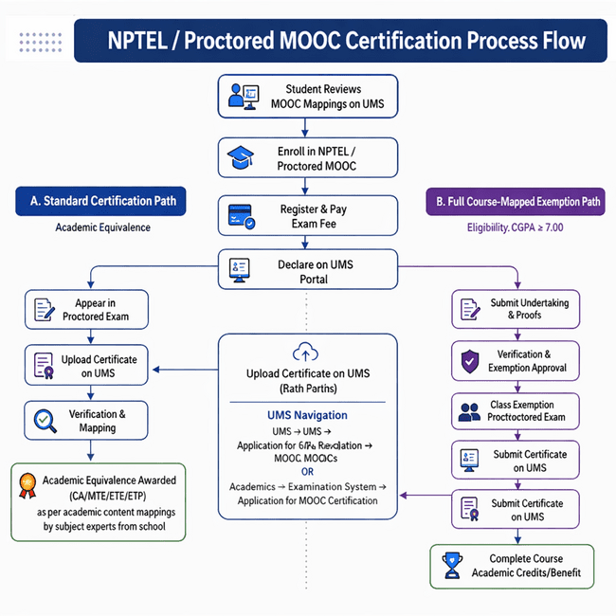

Slide 32
Projects
A Project is a structured, outcome-driven activity undertaken by a student to solve a real-world problem, develop innovation, or conduct academic, industry-oriented, or field-based research under guided supervision.
Eligibility
💡A minimum CGPA of 6.0
💡Duty Leave-related benefits, only if the student has a minimum of 65% attendance
💡Standing Committee approval required for Duty Leave if project work to be done during classes.

Slide 33
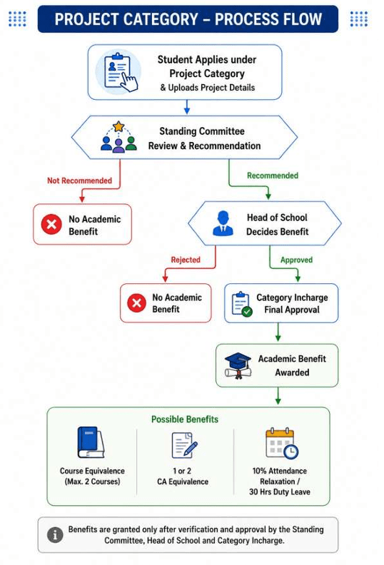

Slide 34
Internship beyond Curriculum
An internship is a supervised, work-based learning experience that provides practical skills and industry exposure. Internships undertaken beyond the curriculum, which demonstrate substantial academic relevance, professional value, and meaningful learning outcomes, shall be considered under this policy.
Eligibility
🌍Minimum CGPA: 6.0 (Exceptional internships may be considered even with CGPA below 6).
🌍Duty Leave: Prior Standing Committee approval is mandatory if the internship requires engagement during scheduled class hours.
🌍Attendance Requirement: Minimum 65% attendance (excluding bonus/Duty Leave) is mandatory to avail Duty Leave benefits.
Mandatory documents to be submitted Offer letter, Completion letter, Stipend proof if appicable

Slide 35
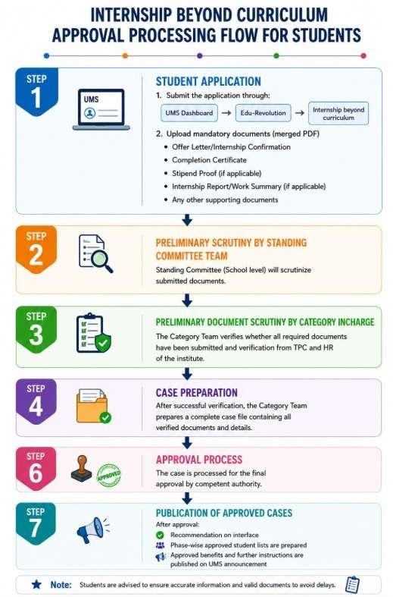

Slide 36
Recognition of Prior Learning (RPL)
Recognition of Prior Learning (RPL) is the process of recognizing a student's prior knowledge and competencies gained through formal, informal, or experiential learning, enabling the student to receive academic recognition for learning already achieved.
Eligibility and conditions
📜Minimum CGPA: 5.0 at the time of application.
📜 Relevant, verifiable evidence of prior learning (minimum 12-hour learning duration, where applicable).

Slide 37
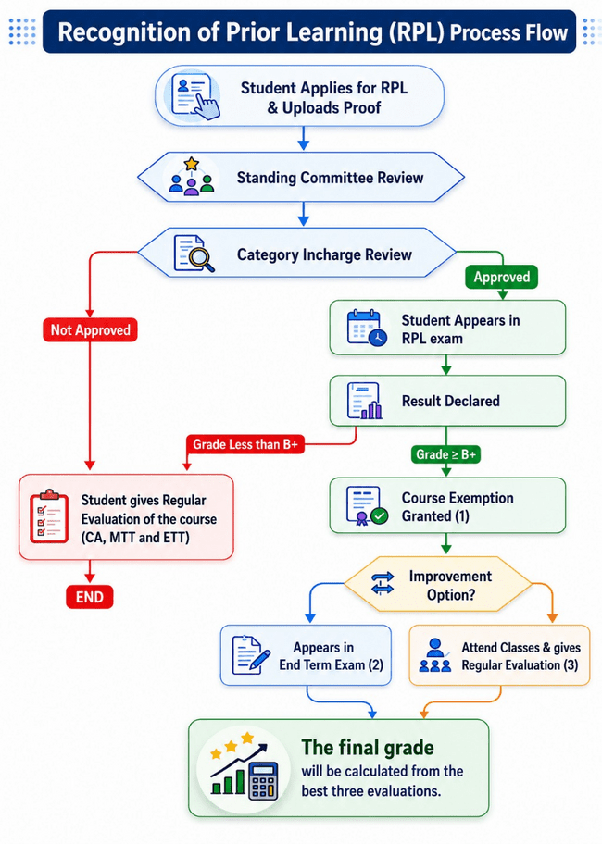

Slide 38
Grade Upgradation
Grade Upgradation is an academic benefit that enhances a student’s course grade based on eligible academic, research, or co-curricular accomplishments.
Eligibility and conditions: ⬆️ A minimum CGPA of 5.0 is required to avail the grade-up benefits.
⬆️ Grade upgradation can be given on the basis of Patent, Scopus publications, copyright/designs, Technical Competitions/Hackathons, Proctored Certification like Oracle, Recruitment Exam, Full Term Paid Internship/Placement, Industry Grade Assessment

Slide 39
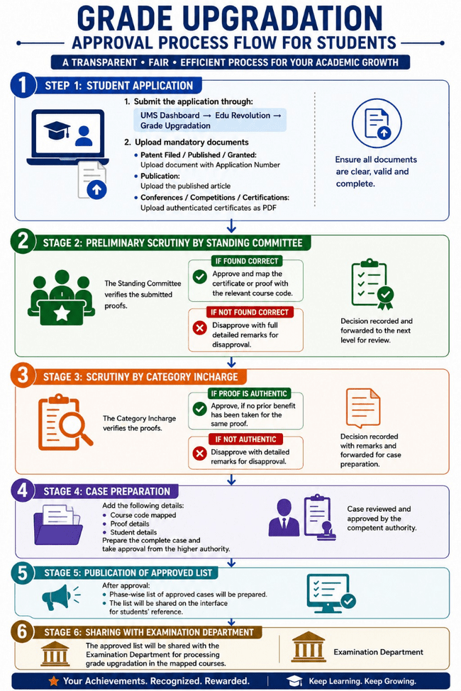

Slide 40
Community Service
Community Service refers to voluntary and unpaid work undertaken by students for the benefit of society, communities, individuals, animals, or the environment.
Eligibility
🤝 Service must be with a University-approved organization or an NGO eligible under Section 80G of the Income Tax Act.
⏳ Minimum 80 hours of community service per semester/term.
📋 Activity must be separate from any credited Community Development Project (CDP) course

Slide 41
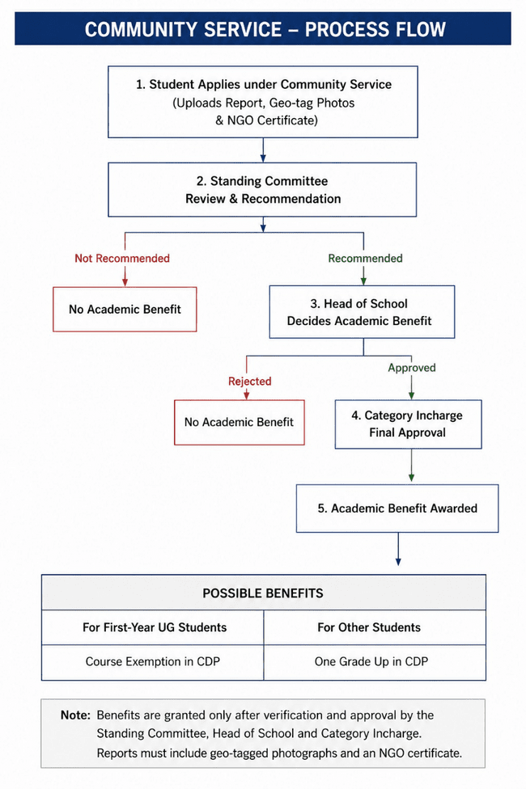

Slide 42
Up to 10 % Attendance Benefit
Attendance Benefit refers to a provision through which eligible students may receive up to 10% attendance relaxation for participation in approved academic, professional, recruitment, competitive examination, research, innovation, entrepreneurship, or other institutionally approved activities.
Eligibility
📅Minimum CGPA of 7.5
📅Minimum 65% aggregate attendance by the end of the term.
📅No record of indiscipline during the academic session.
📅Must be in the pre-final or final year (for programmes of duration greater than three years); otherwise, only final-year students shall be eligible.
📅 Students must appear in and qualify the prescribed mock test conducted by the University, wherever applicable.

Slide 43
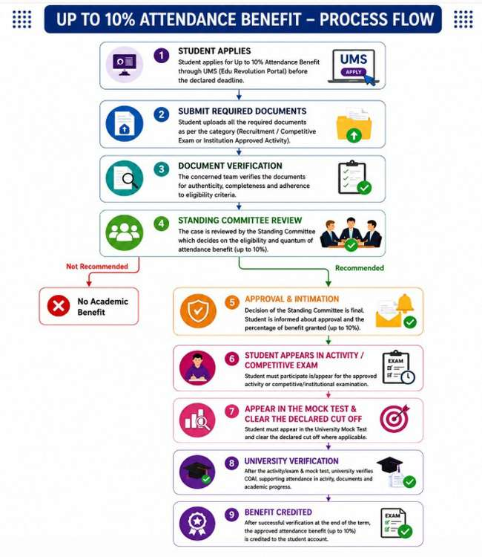

Slide 44
Duty Leave (DL)
Duty Leave (DL) refers to attendance relaxation granted to students for participation in approved academic, recruitment, competitive examination, co-curricular, professional, research, innovation, or institutional activities conducted during scheduled class hours. Eligibility
✈ Students must maintain a minimum of 60% attendance
✈The student must have no record of indiscipline.
✈ For recruitment or competitive examinations or events, the examination or event must be relevant to the student's current academic programme.

Slide 45
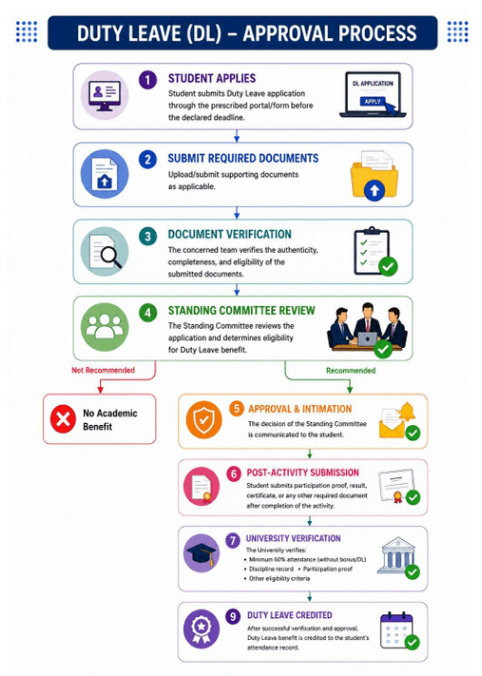

Slide 46
Semester Abroad
It is a structured academic mobility program that allows students to study at a partner, host, or foreign university for one or more academic semesters while continuing to remain enrolled at LPU.
During this period, students earn academic credits that may be transferred towards the completion of their degree at the home university, subject to the academic requirements of both institutions.

Slide 47
Eligibility
Valid passport (minimum 6 months validity beyond intended stay).
Minimum CGPA: 6.5 and fulfil host university eligibility criteria.
No re-appears/backlogs (up to 2 re-appears may be considered in exceptional cases).
Meet the English/other language requirements of the host university.
Parent/Guardian consent is mandatory.
First-semester and final-semester students are not eligible.

Slide 48
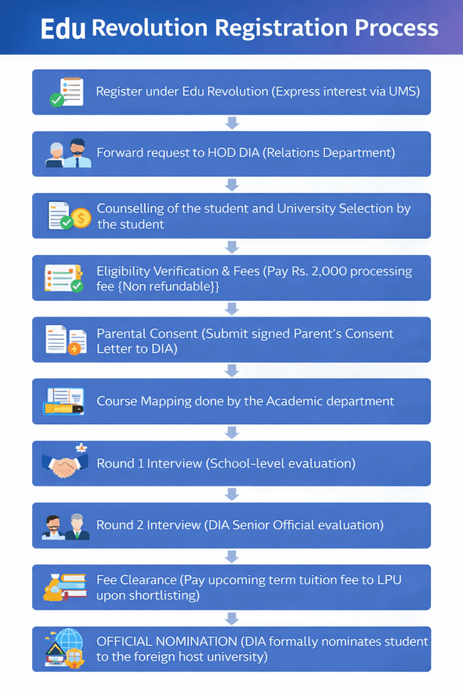
Process of approval for Semester Abroad

Slide 49
Require assistance?
🆘 Assistance | 💻 Application Process
🏢 Assistance Zone (Room 38-205B) | 💻 Login to UMS
💬 Queries & Guidance | ➜ LMS
🤝 One-to-one Support | ➜ Edu Revolution: Be the Change
 | ➜ Apply for EDU Revolution

Slide 50
RPL
https://onlinecourses.nptel.ac.in/noc25_cs16/preview
Certified Information Systems Security Professional (CISSP)
Certified Information Security Manager (CISM)
Certified Information Systems Auditor (CISA)
Certified Ethical Hacker (CEH)
Certified Encryption Specialist (ECES)
Certified Cryptographer (CC)
Certified Cloud Security Professional (CCSP)
Certified Information Privacy Professional (CIPP)
https://onlinecourses.swayam2.ac.in/cec25_cs03/preview

Slide 51
THANK YOU

